Slide 1

High Impact Skills Development Program
in Artificial Intelligence, Data Science, and Blockchain
Module 1: AI Fundamentals
Lecture 5: Probability, Statistics, and Linear Algebra
Instructor: Dr Adnan Ul-Hasan
Team Lead, Deep Learning Lab, NCAI

Slide 2
Why worry about the math?
These intuitions will allow you to:
Choose the right algorithm(s) for the problem
Make good choices on parameter settings, validation strategies
Recognize over- or underfitting
Troubleshoot poor / ambiguous results
Put appropriate bounds of confidence / uncertainty on results
Do a better job of coding algorithms or incorporating them into more complex analysis pipelines

Slide 3
Outline
Probability
Statistics
Linear Algebra
With relevance to Data Science and Machine Learning.

Slide 4
Probability
It is an important element in predictive analysis allowing you to explore the computational math behind your outcome.
Using a simple example, let's look at tossing a coin: either heads (H) or tails (T). Your probability will be the number of ways an event can occur divided by the total number of possible outcomes.
If we want to find the probability of heads, it would be 1 (Head) / 2 (Heads and Tails) = 0.5.
If we want to find the probability of tails, it would be 1 (Tails) / 2 (Heads and Tails) = 0.5.

Slide 5
Fundamentals of Probability
What is Probability and how it is defined?
Sample space, events, outcomes
Axioms of Probability
Pr{A} ≥ 0 | Pr{S}=1 | If 𝐴1 ∩ 𝐴2 = Ø, Then, Pr{𝐴1 𝖴 𝐴2} = Pr{𝐴1} + Pr{𝐴2}
Mutual Exclusivity
Pr{𝐴₁ 𝖴 𝐴₂} = Pr{𝐴₁} + Pr{𝐴₂} – Pr{𝐴₁ ∩ 𝐴₂}
Conditional Probability
P(A occurs given that B has occurred)
Joint Probability
The probability of two or more events occurring together

Slide 6
Probability Distributions
A mathematical function that gives the probabilities of occurrence of different possible outcomes for an experiment.
Used in data science and machine learning to:
Model real-world phenomenon
Predictions
Types of PDs:
Continuous PDs: Normal
Discrete PDs: Poisson, Binomial

Slide 7
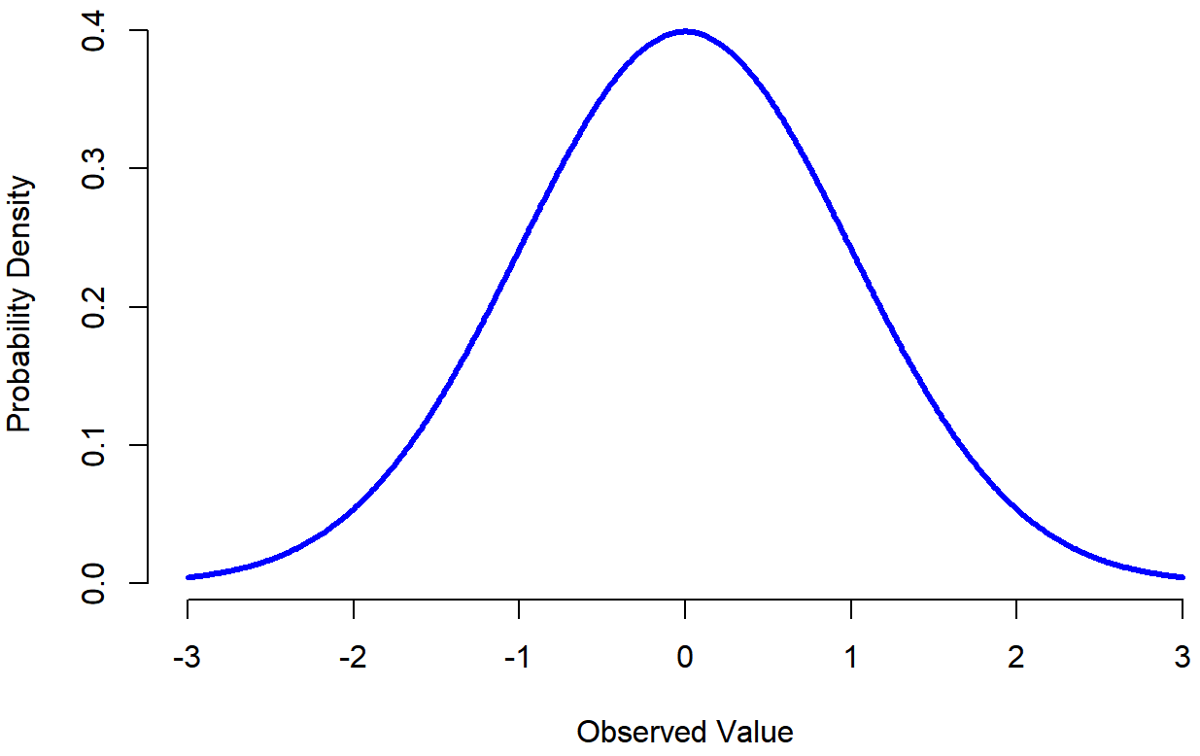
Normal Distribution
To model normally distributed phenomenon
Heights
Weights
IQs
Dice rolling
Properties
It is symmetric around the mean.
It has a bell-shaped curve.
The mean and standard deviation fully describe the distribution.
It is a continuous distribution.

Slide 8
Binomial Distribution
To model the number of successes in a fixed number of trials
whether a customer will make a purchase or not
Properties
It is a discrete distribution.
It has two parameters, which are the number of trials and the probability of success.
The mean equals the product of the number of trials and the probability of success.
It is often used to model binary outcomes.

Slide 9
Poisson Distribution
To model the number of times an event occurs in a given time period
the number of website visits or
the number of defects in a product
Properties
It is a discrete distribution.
It has a single parameter, which is the mean.
The variance equals the mean.
It is often used to model rare events.

Slide 10
Conditional Probability
Given that event B has already occurred, what is the probability that event A will occur?
Given that event B has already occurred, reduces the sample space of A
Example:
Toss a balanced die once and record the number on the top face.
Let A be the event that a 2 shows on the top face.
Let B be the event that the number on the top face is even.
What is P(A)?
What is the Probability of the event A if we are told that the number on the top face is even, that is, we know that the event B has occurred?

Slide 11
Conditional Probability
The new or reduced sample space is
S={2, 4, 6}
Notice that the new sample space consists only of the outcomes in B.
P(A occurs given that B has occurred) = 1/3
Notation: P(A|B) = 1/3

Slide 12
Bayes' Theorem
Provides a way to update our beliefs about an event based on new evidence
To update model’s parameters based on data
P(A|B) = P(B|A) * P(A) / P(B)
P(A|B) is the probability of A given B,
P(B|A) is the probability of B given A,
P(A) is the prior probability of A, and
P(B) is the prior probability of B
Bayesian Inference
Bayesian inference is a way of updating our beliefs about model parameters based on data. It involves specifying a prior distribution for the parameters

Slide 13
Example
Let us say P(Fire) means how often there is fire, and P(Smoke) means how often we see smoke, then:
P(Fire|Smoke) means how often there is fire when we can see smoke
P(Smoke|Fire) means how often we can see smoke when there is fire
Data
dangerous fires are rare (1%)
smoke is common (10%) due to barbecues,
90% of dangerous fires make smoke
Probability of dangerous Fire when there is Smoke:
P(Fire|Smoke) = P(Fire) P(Smoke|Fire)/P(Smoke)
= 1% x 90%/10%
= 9%

Slide 14
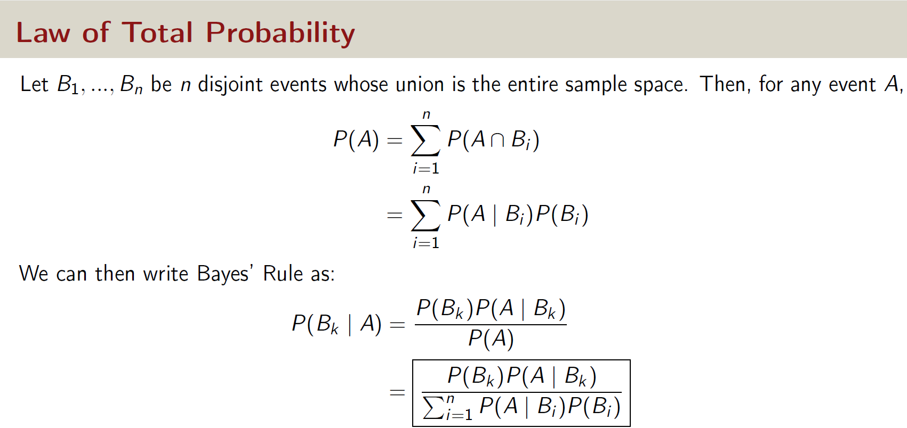
CS229 Probability Review Spring 2022
7 / 49

Slide 15
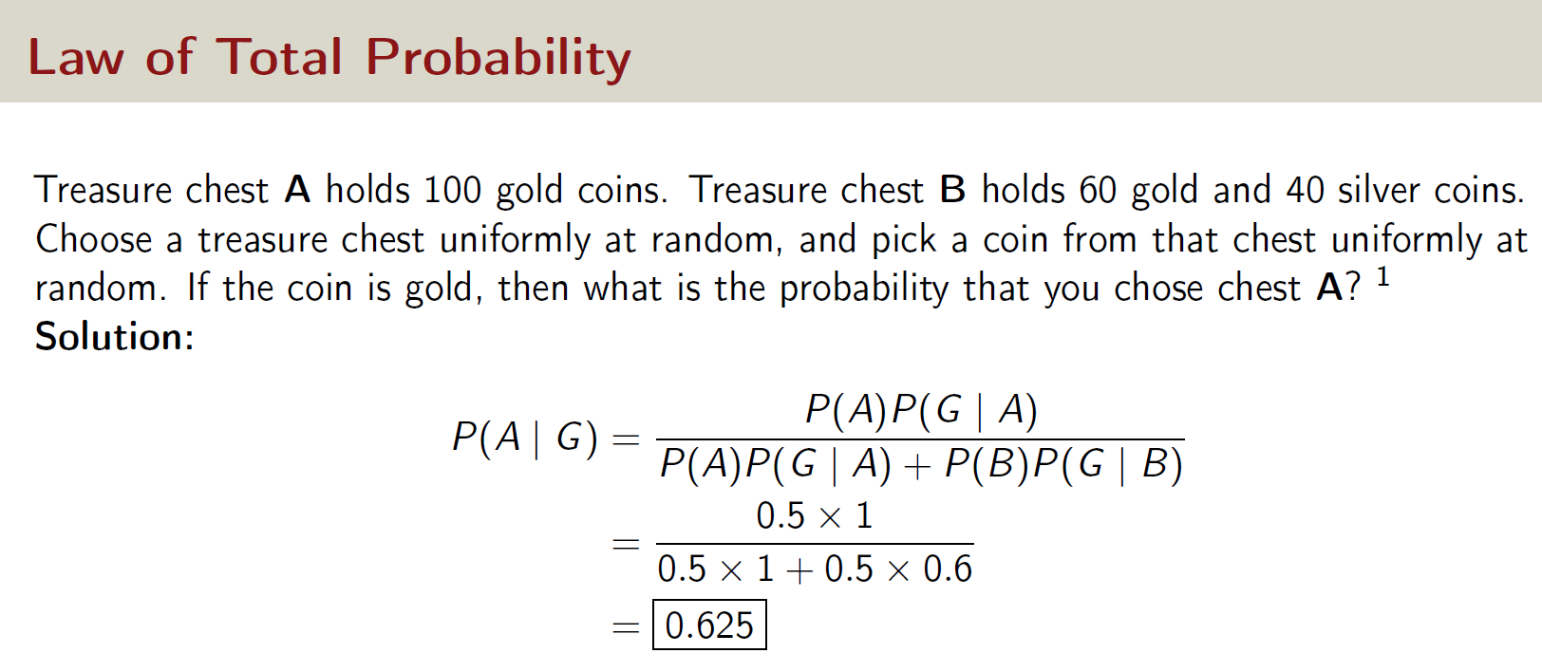
CS229 Probability Review Spring 2022
7 / 49

Slide 16
Joint Probability
The probability of two or more events occurring together
to model the relationship between multiple variables.
Joint probability can be calculated using the product rule.
Example
predict the likelihood of car accidents
given the weather conditions and the time of day, what is the probability that a car accident will occur?
By calculating the joint probability of these variables, we can build a model to predict the likelihood of car accidents.

Slide 17
Random Variables
A random variable is a variable whose value is determined by chance
Examples of random variables: the number of website visits, the temperature, and the stock price.
Important Terminologies
Expected Value: Average value that random variable takes over many trials
Variance and Standard Deviation: how spread out the distribution is?
Covariance and Correlation: measure the relationship between two variables
Central Limit Theorem: distribution of the sample means approaches a normal distribution as the sample size increases, regardless of the underlying distribution of the population

Slide 18
Statistics in Data Science and ML
Statistics is the foundation of machine learning and data science, allowing for the extraction of useful insights from data across multiple domains.
Machine learning algorithms can use statistical techniques and methodologies to learn from data, generate predictions, and solve complicated problems successfully

Slide 19
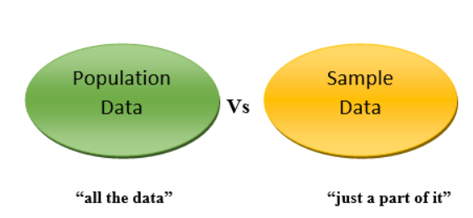
Population vs Sample
to make predictions about the behavior of a system based on a small sample size

Slide 20
Political Polling
Take a small set of population
Take a survey
Extrapolate the results on small sample to the whole population

Slide 21
Important Terms
Central Tendency: Typical values of the data
Measured by Mean, Median, Mode
Variability: How spread out a set of data is.
Measured by Range, Variance, Standard Deviation
Regression Analysis
a statistical method for modeling the relationship between two or more variables.
Linear regression, logistic regression, and polynomial regression.
Bayesian Inference
updating our beliefs about a system based on new data.

Slide 22
Linear Algebra
Linear Algebra is a branch of mathematics that deals with linear equations and their representations in vector spaces.
It involves the study of vectors, matrices, and linear transformations.
Dimensionality reduction techniques

Slide 23
Vectors
A vector is a quantity that has both magnitude and direction.
In linear algebra, a vector can be represented as an ordered list of numbers, or as a column or row matrix.
```
import numpy as np
# Define two vectors
v1 = np.array([1, 2, 3])
v2 = np.array([4, 5, 6])
# Add the two vectors
v3 = v1 + v2
print(v3) # Output: [5 7 9]
```

Slide 24
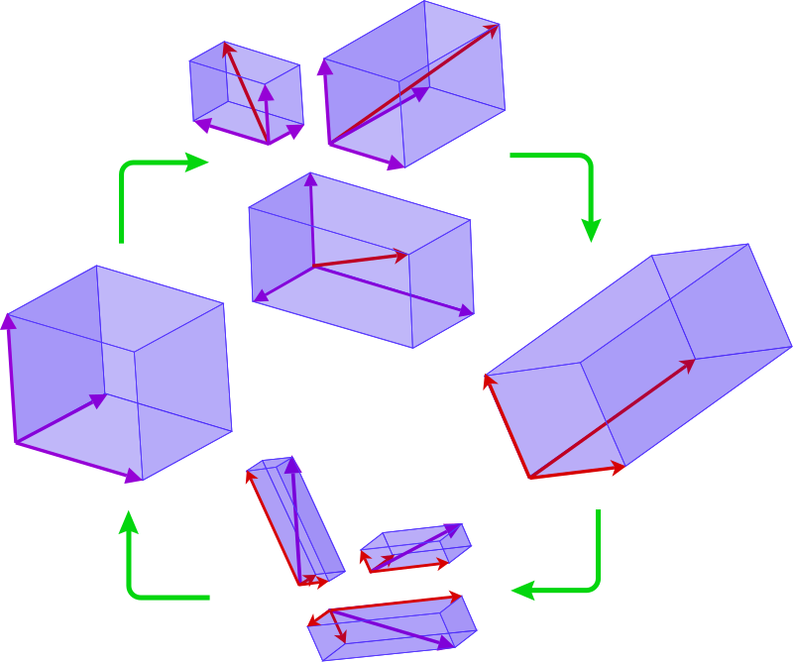
Linear Transformation
A linear transformation is a function that maps one vector space to another in a way that preserves certain properties, such as linearity and distance.
Linear transformations can be represented as matrices, and they can be used to perform operations such as rotations, translations, and scaling.

Slide 25
Matrices
A matrix is a rectangular array of numbers.
Matrices can be used to represent systems of linear equations, transformations of geometric shapes, and many other mathematical concepts.
Matrices can be added and multiplied together, and they can be transposed or inverted.

Slide 26
Matrix: Rectangular array of numbers:
Dimension of matrix: number of rows x number of columns

Slide 27
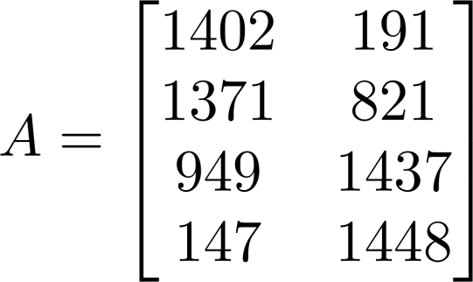
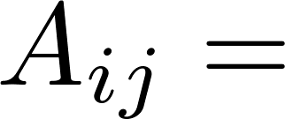

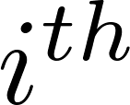

Matrix Elements (entries of matrix)
“ , entry” in the row, column.

Slide 28
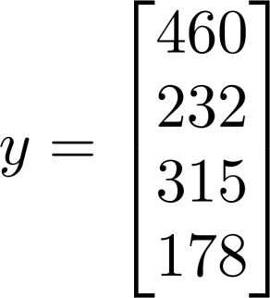
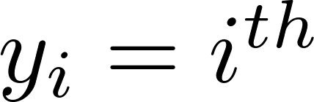
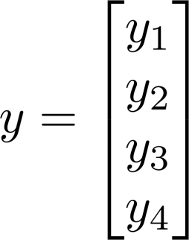
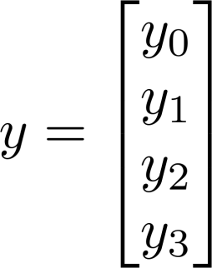
Vector: An n x 1 matrix.
1-indexed vs 0-indexed:
element
n-dimensional vector

Slide 29
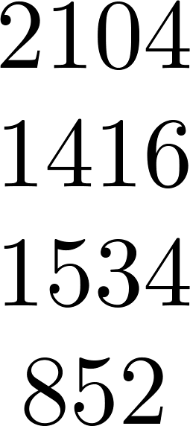
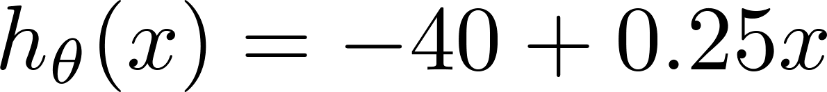
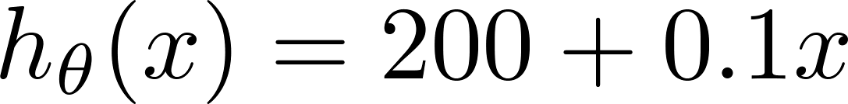
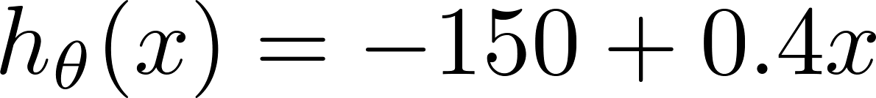
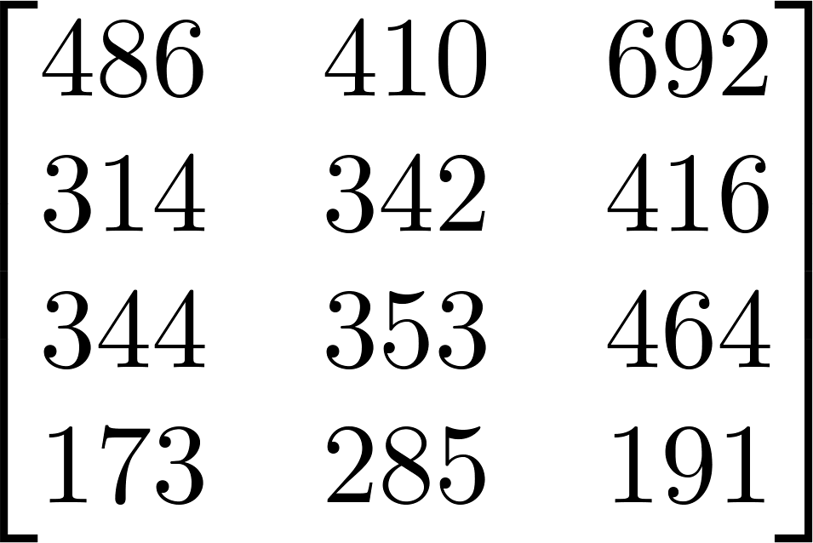
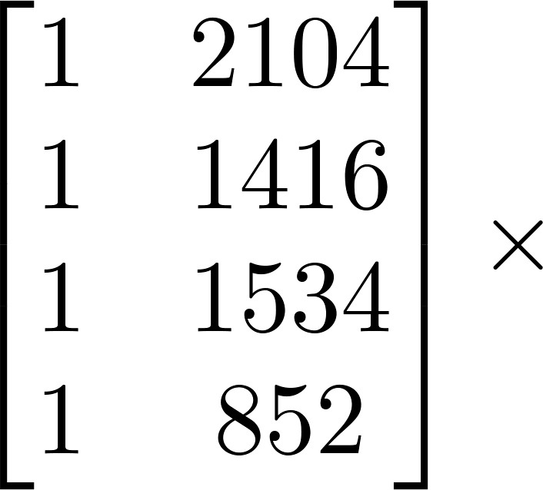
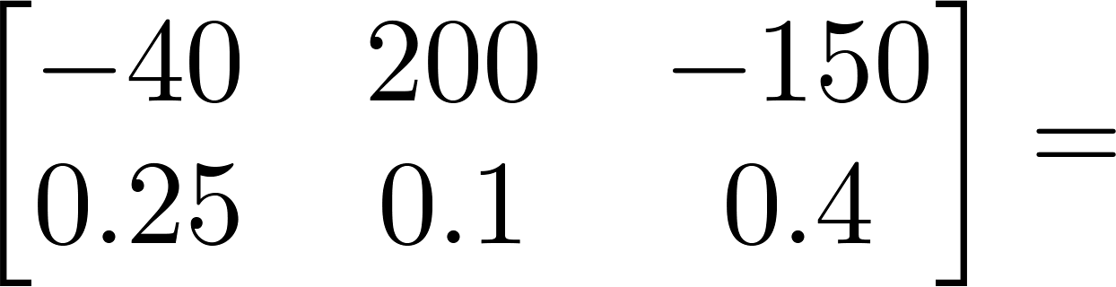
Example: house price prediction
House sizes:
Have 3 competing hypotheses:
1.
2.
3.
Matrix
Matrix

Slide 30

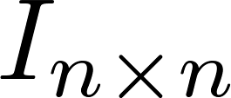
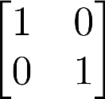
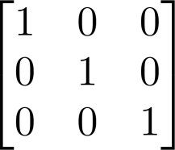
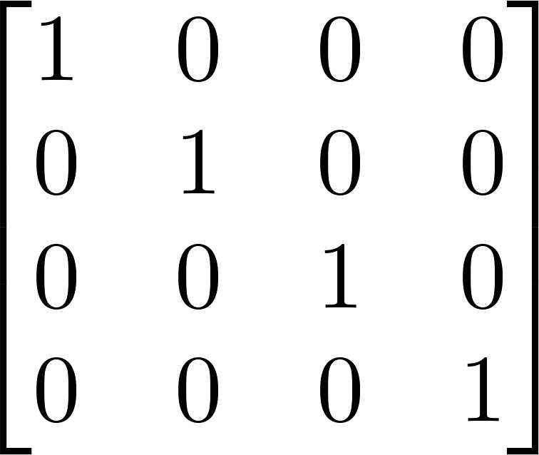

Identity Matrix
Denoted (or ).
Examples of identity matrices:
2 x 2
3 x 3
4 x 4
For any matrix ,

Slide 31
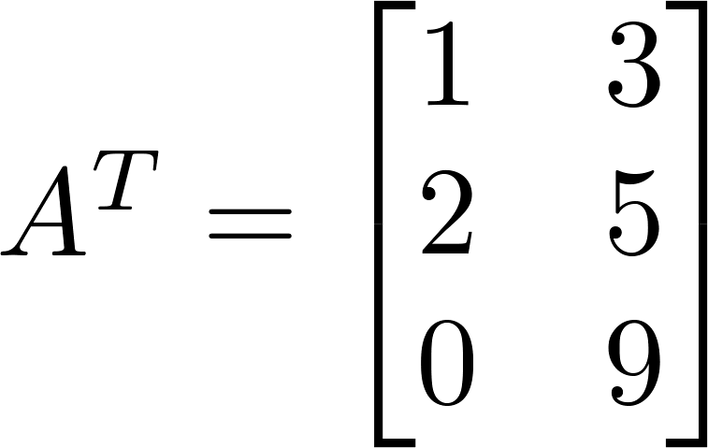
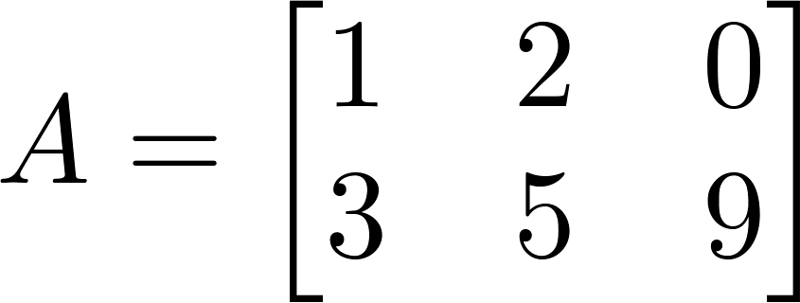
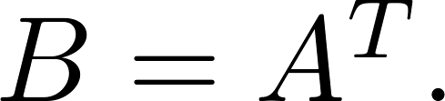

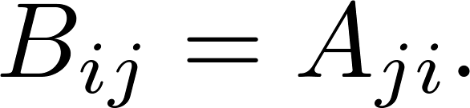
Matrix Transpose
Example:
Let be an m x n matrix, and let
Then is an n x m matrix, and

Slide 32
Applications of Linear Algebra
Regression Analysis
Principal Component Analysis
Neural Networks
Support Vector Machines
Recommender Systems

Slide 33

Happy Learning!

